Slide 1
DD2437 Artificial Neural Networks and Deep Architectures
Restricted Boltzmann Machines and Deep Belief Nets
Lab 4 Presentation
Patrick Jonsson, Márk Csizmadia
February 2021

Slide 2
Objectives
Learn about Restricted Boltzmann Machines and Deep Belief Nets
Finish the implementation of the skeleton code and use this code to reconstruct images of digits
Design and use Deep Belief Nets, use them as generative and discriminative models

Slide 3
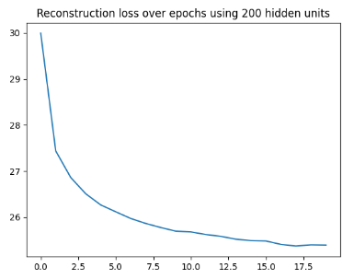
RBM for recognising MNIST images
Weights sampled from N(0, 0.01), train with minibatches of 20, for 20 epochs
We monitor the averaged error between the input and the reconstructed input.
What does this convergence of error mean for the reconstructed result?

Slide 4
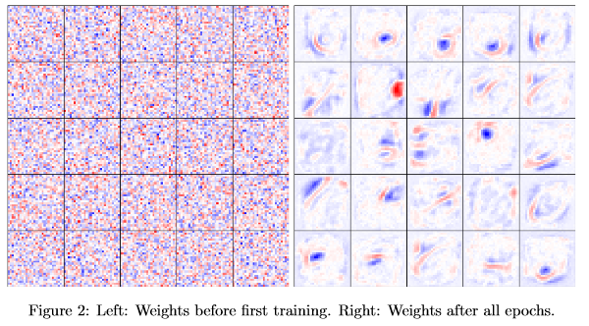
RBM for recognising MNIST images
Just because error converges, does not mean the reconstruction is good!
We check weights so that they are within a reasonable range numerically.
Visualize the weights every few epochs to see if they seem stable - they do.

Slide 5
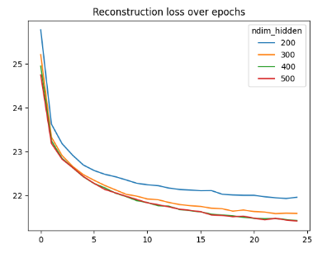
RBM for recognising MNIST images
Applying wider RBMs to the same problems gives some small improvement
Empirically we found lowering the batch size more important to lower error
At the cost of additional training time!
Visualizing the reconstructed input the representation still is not great

Slide 6
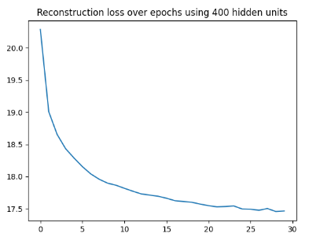
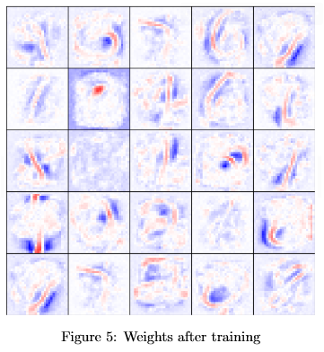
RBM for recognising MNIST images
Training an RBM with 400 hidden units, with minibatches of size 15
Numerically the reconstruction error it is lower than before
The resulting weights is still not a great representation

Slide 7
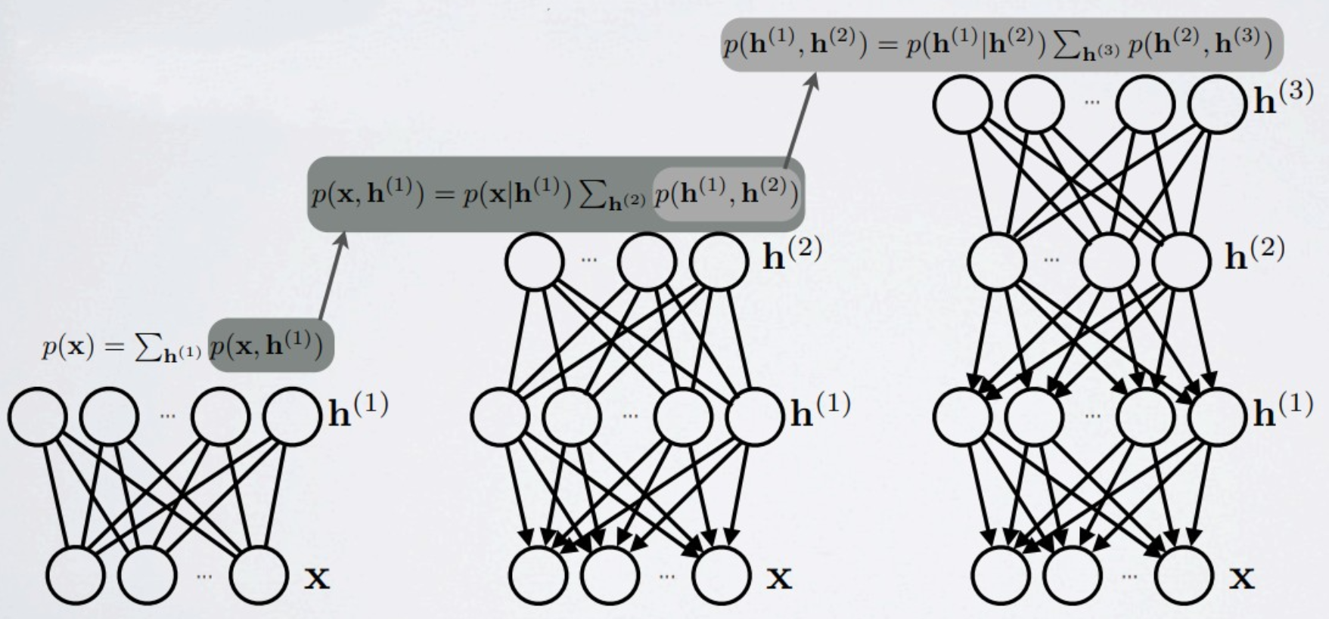
Towards deep networks - greedy layer-wise pretraining
After learning the RBM, the weights can be kept fixed and the representations obtained in the hidden layer can be treated as input training data for another RBM stacked on top, etc. = Deep Belief Network
Hugo Larochelle, Neural Networks, Deep Belief Networks

Slide 8
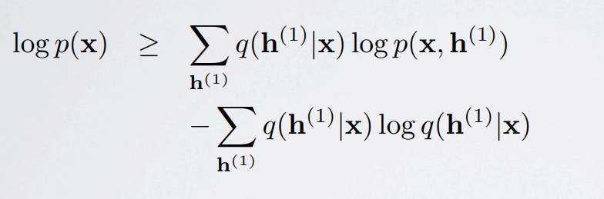
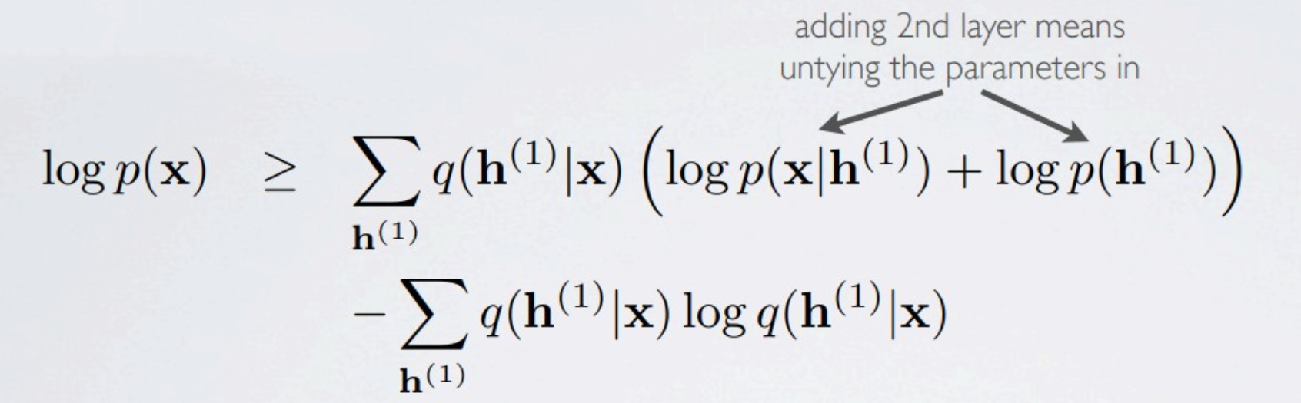
Untying Weights in DBNs
When stacking RBMs, the originally undirected connections become directed in the bottom two RBMs except the top one
By initializing the weights of the second layer RBM as the transpose of the first layer weights, the bound is initially tight (a 2 layer DBN with tied weights is equivalent to a 1 layer RBM)
Untying weights means maximizing the variational lower bound of the data log-likelihood in all RBMs
Hugo Larochelle, Neural Networks, Deep Belief Networks

Slide 9
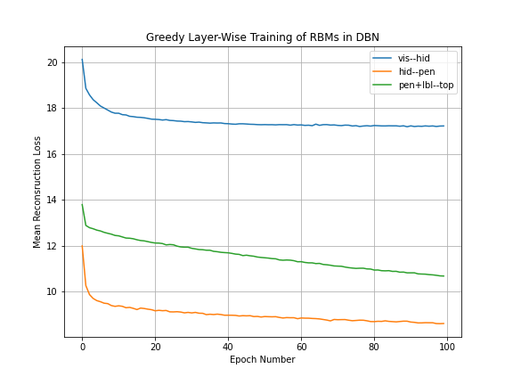
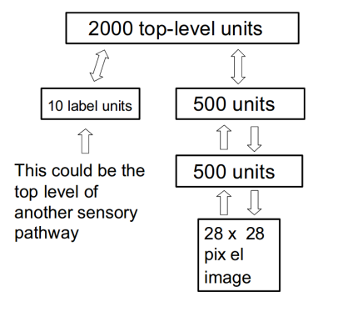
Task & Training Performance on Task
3 RBM DBN
vis → hid
hid → pen
pen + lbl → top
MNIST, labels concatenated to pen
Curves for the 3 RBMs
Hinton et. al. 2006

Slide 10
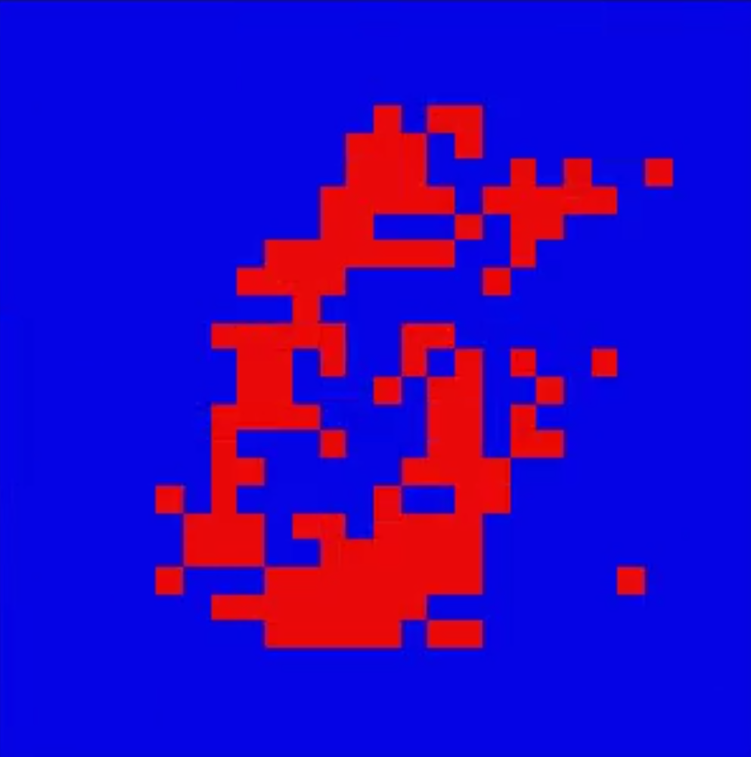
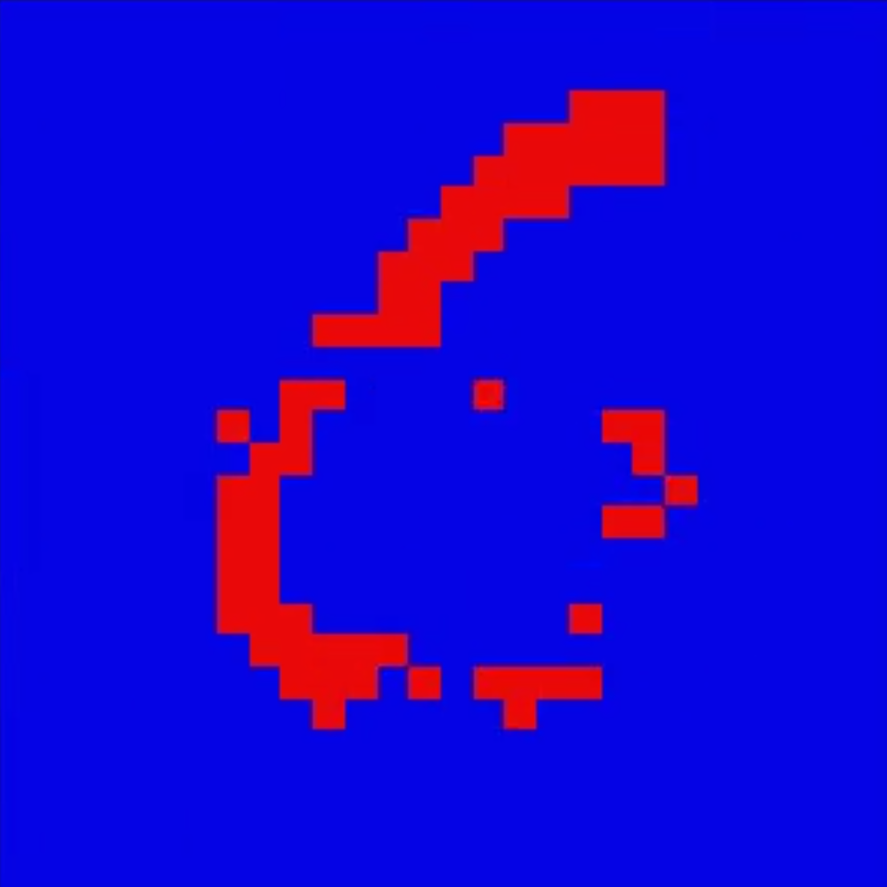
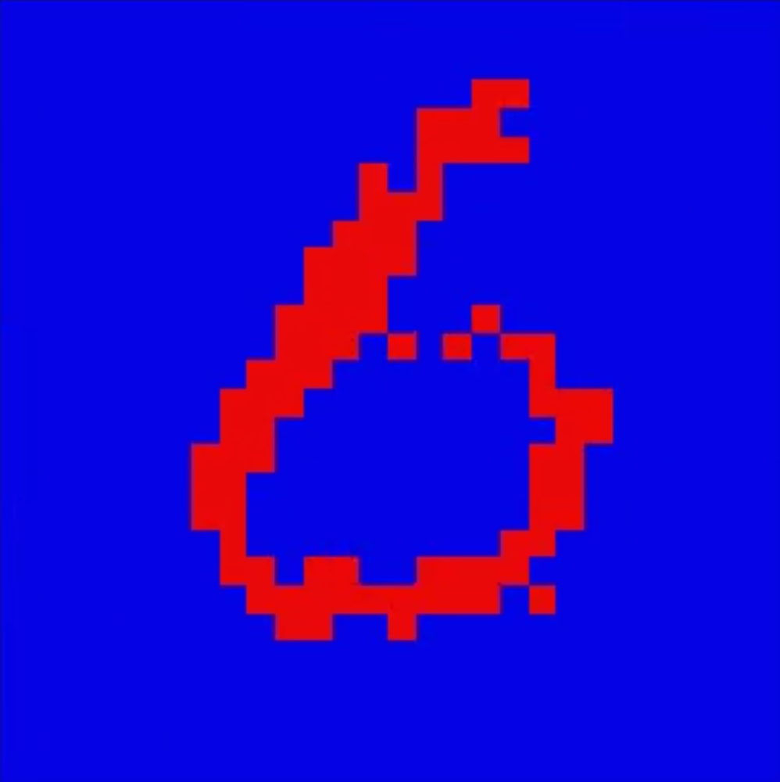
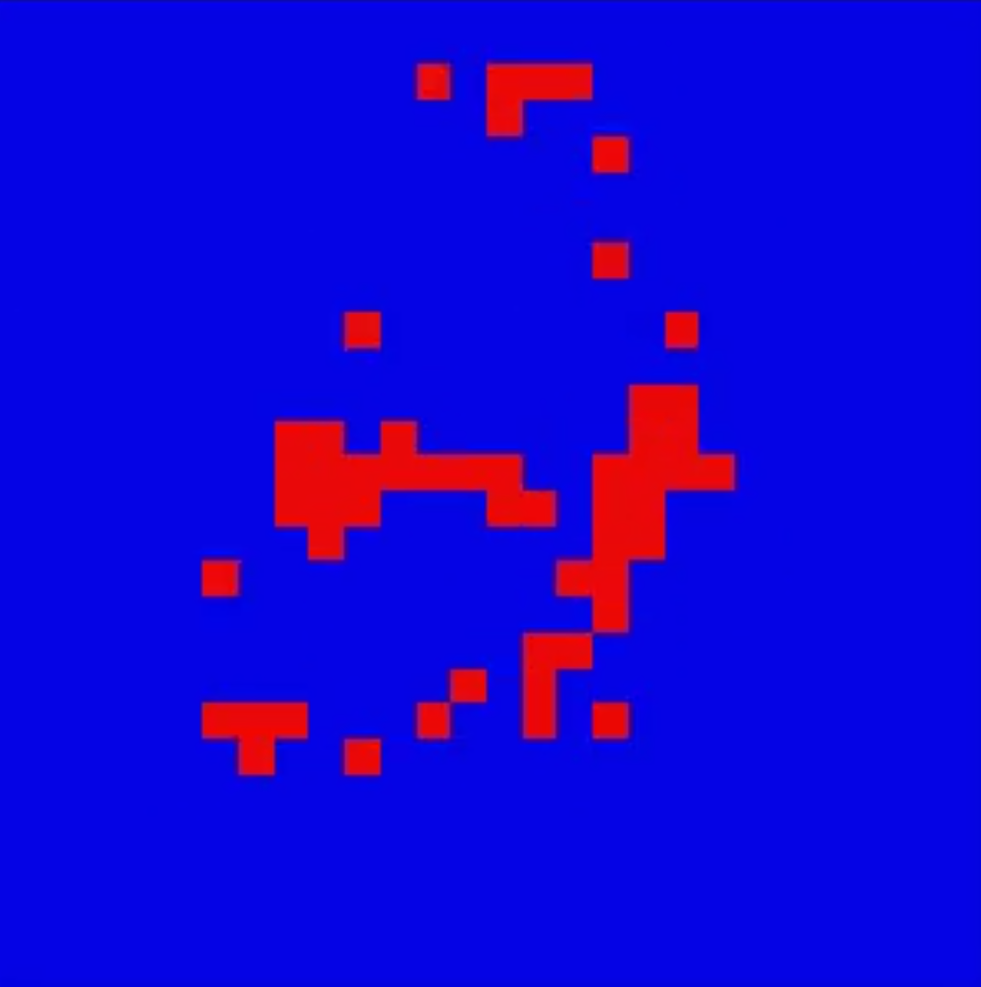
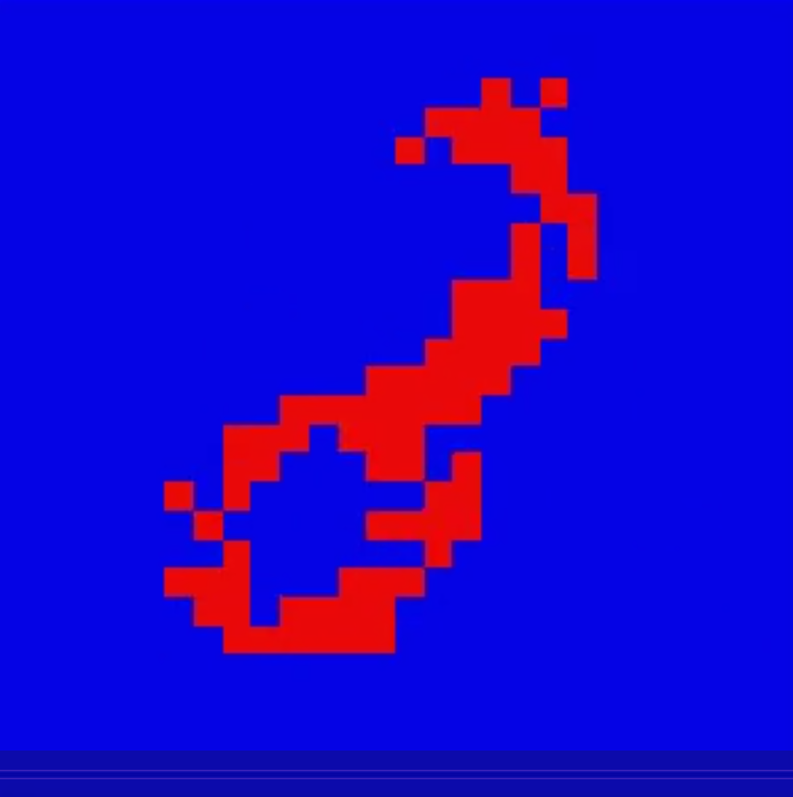
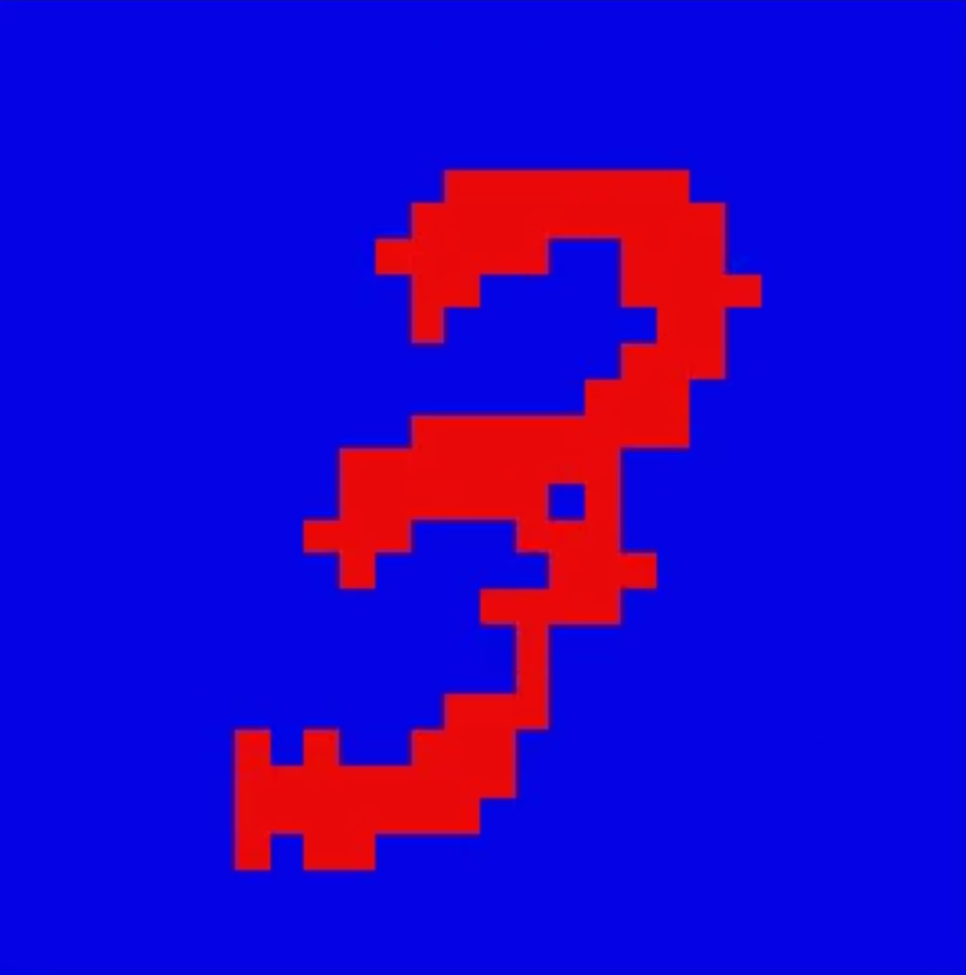
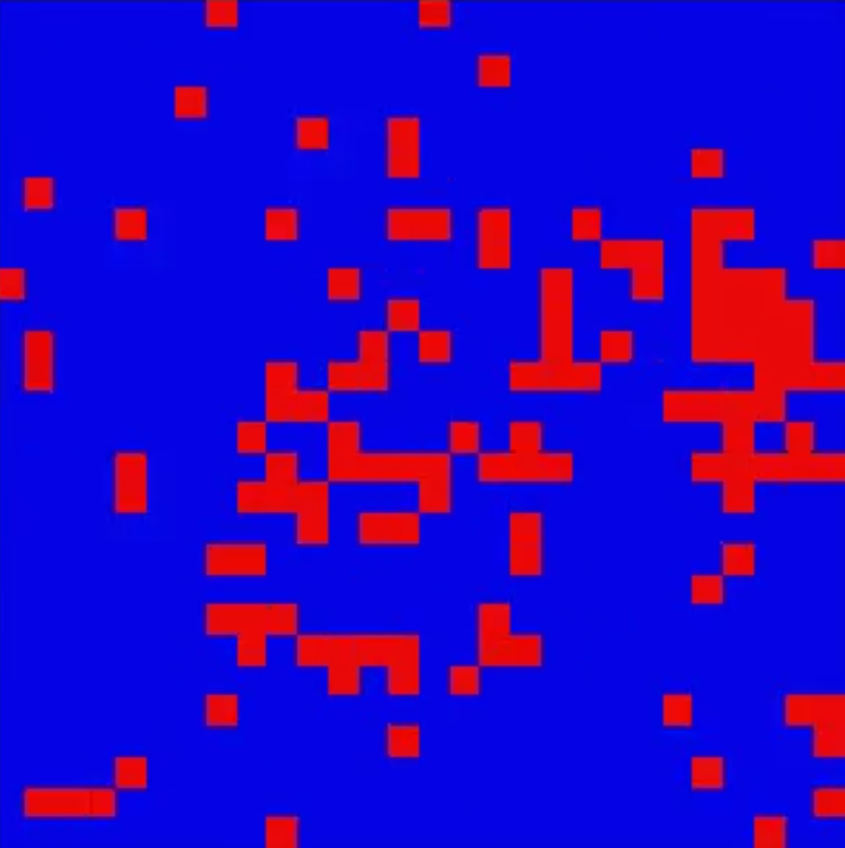
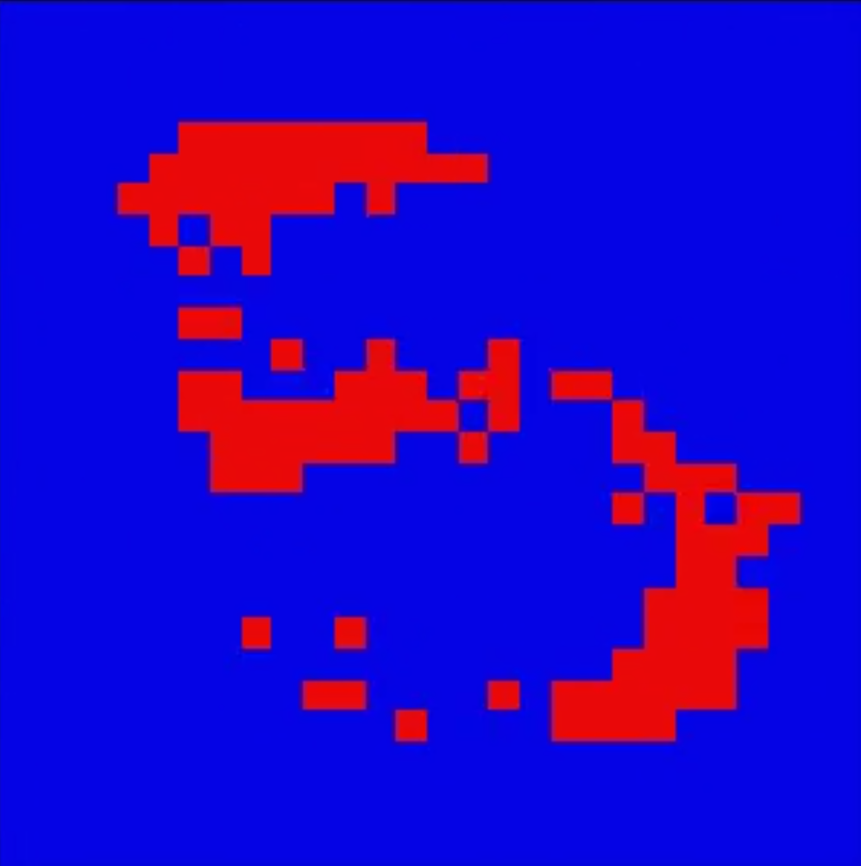
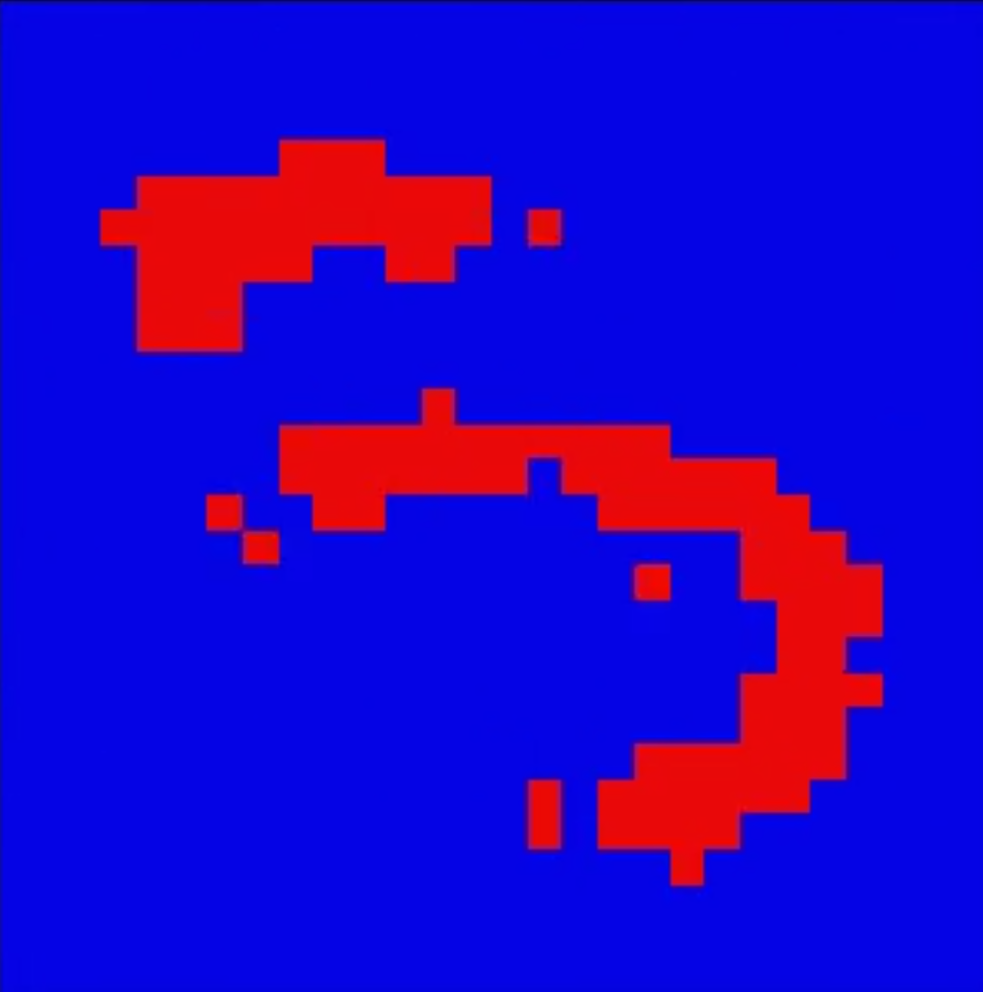
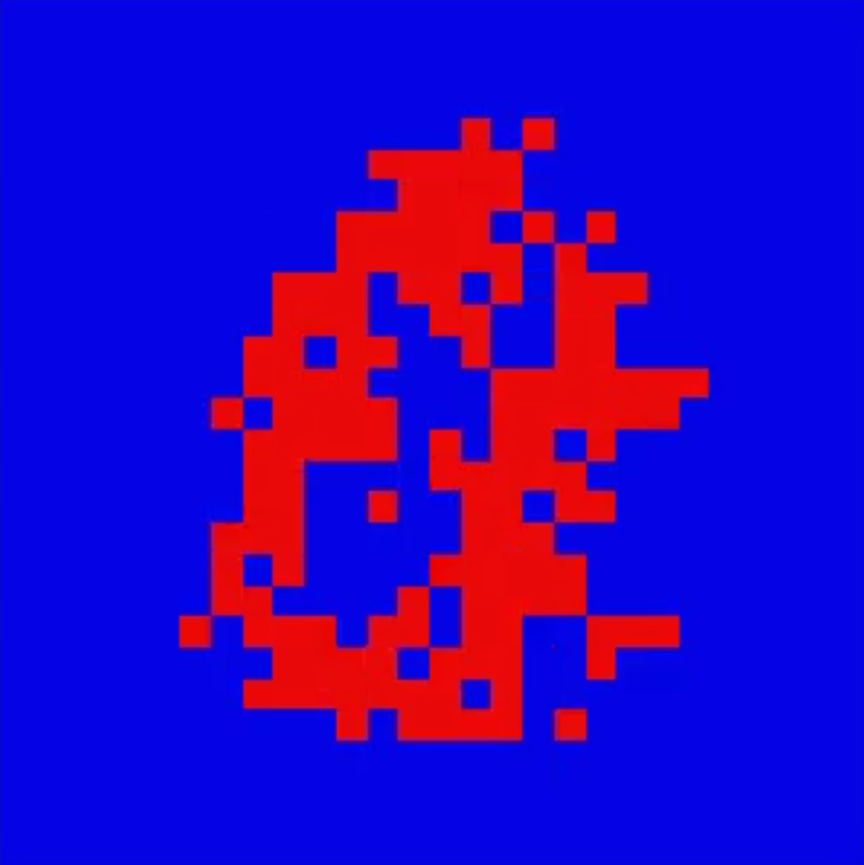
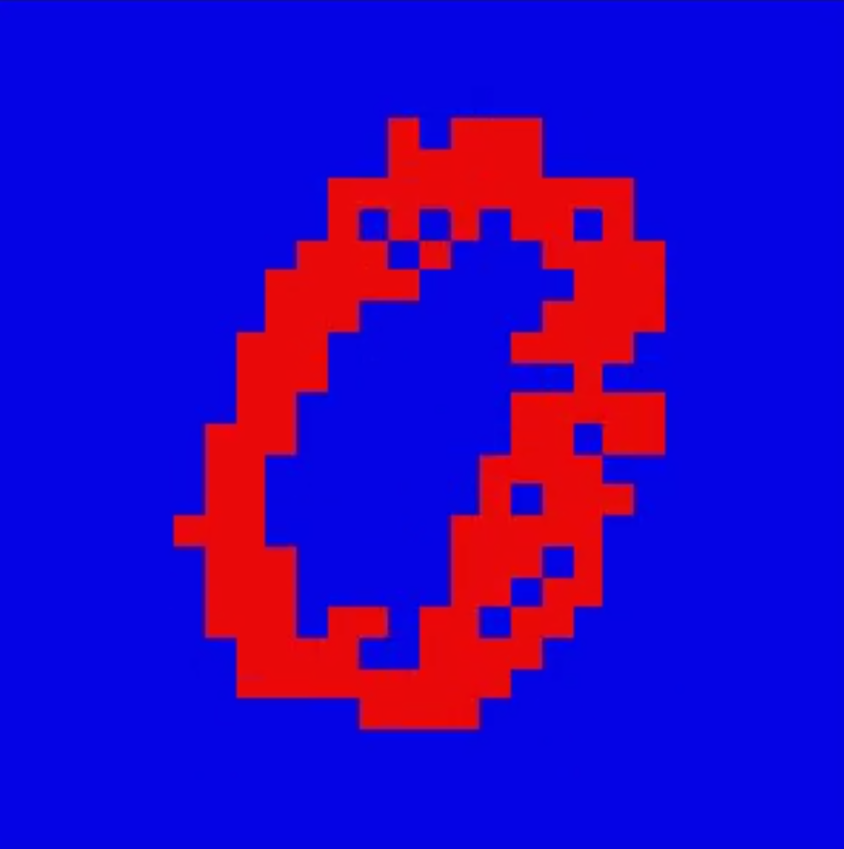
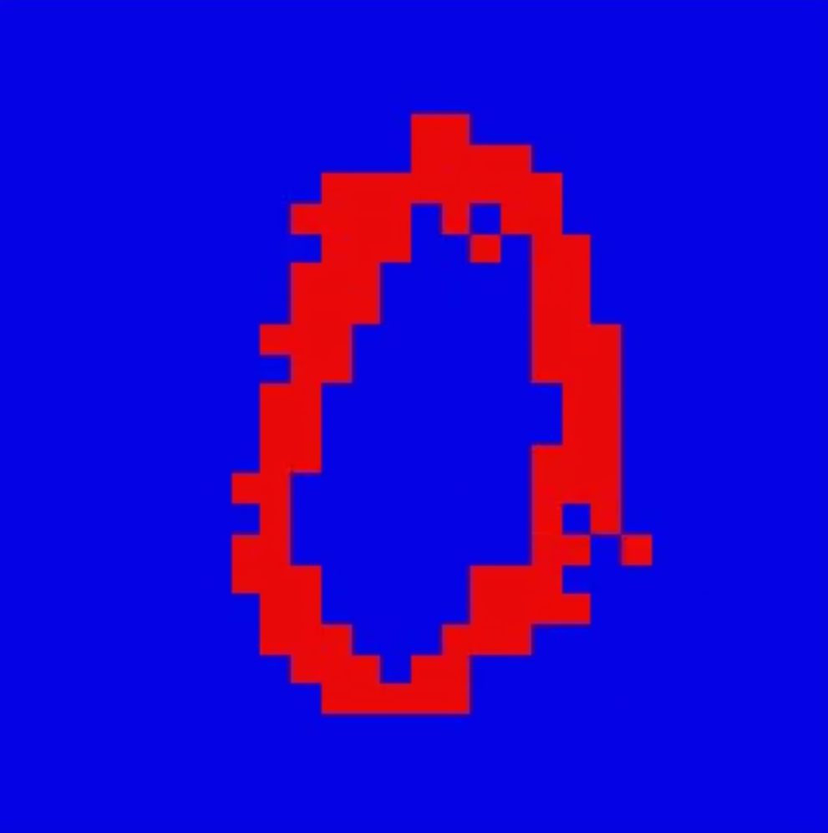
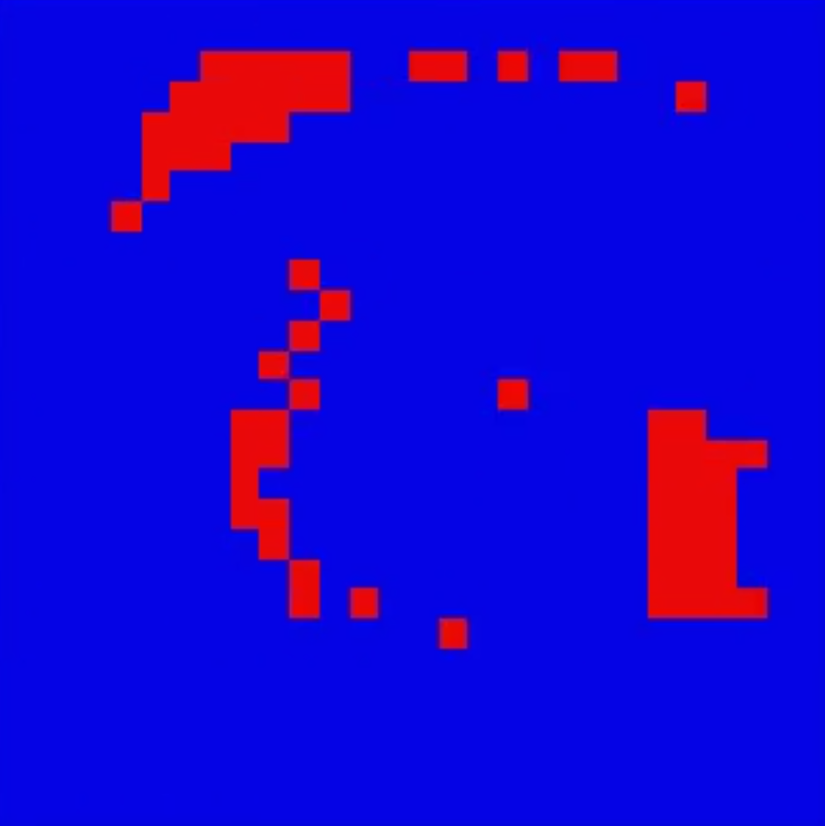
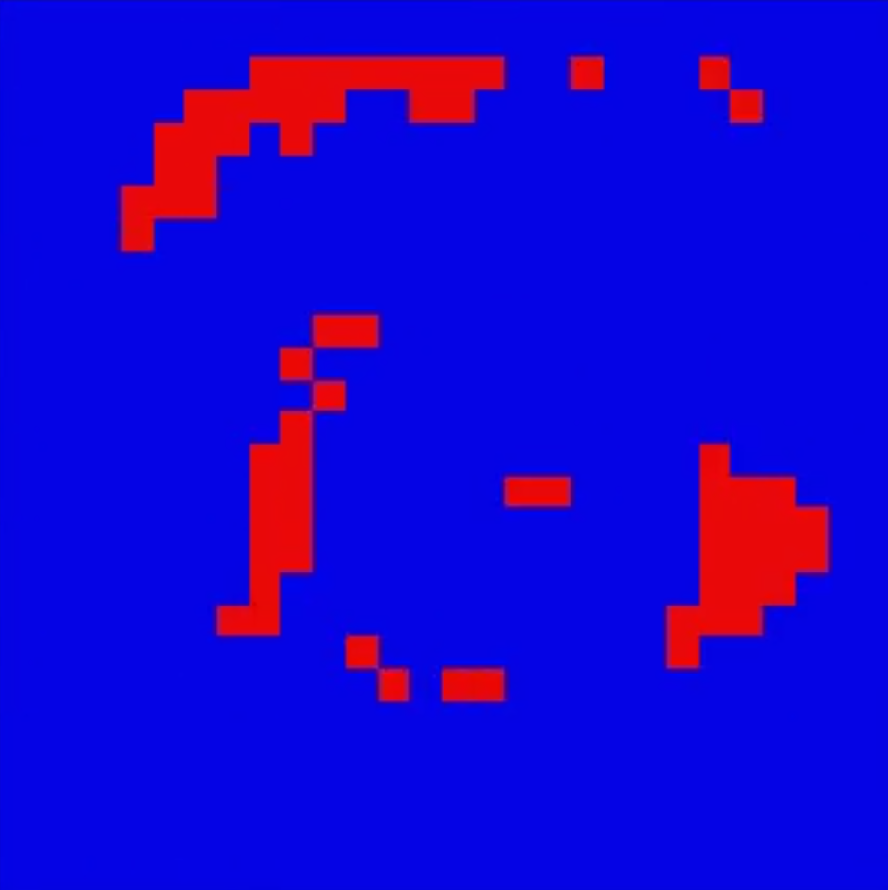
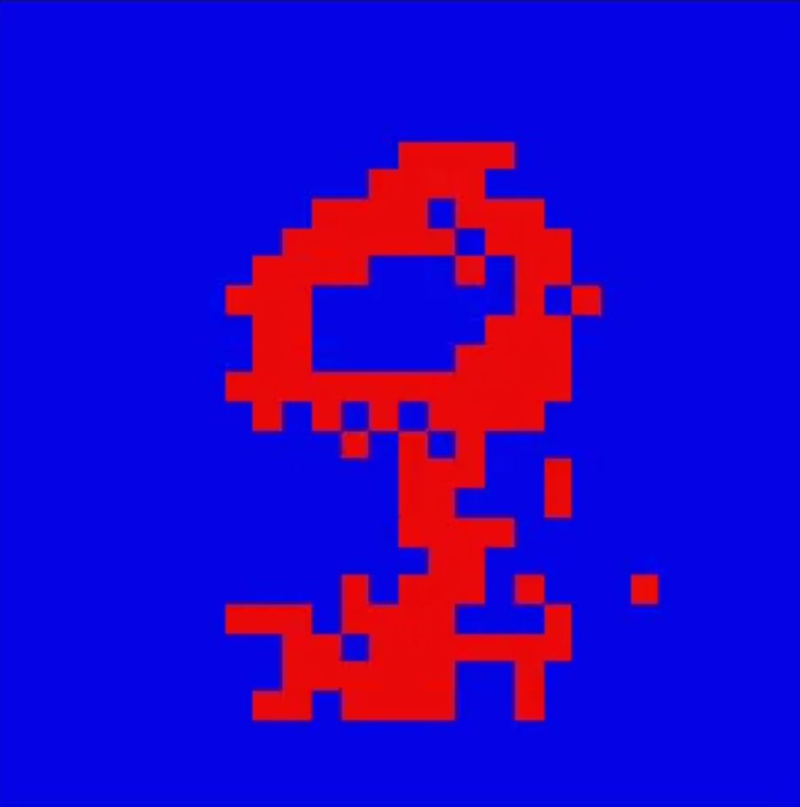
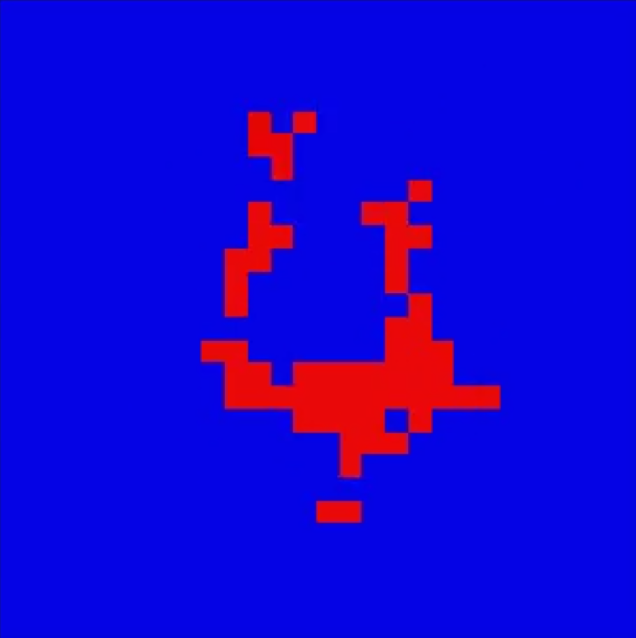
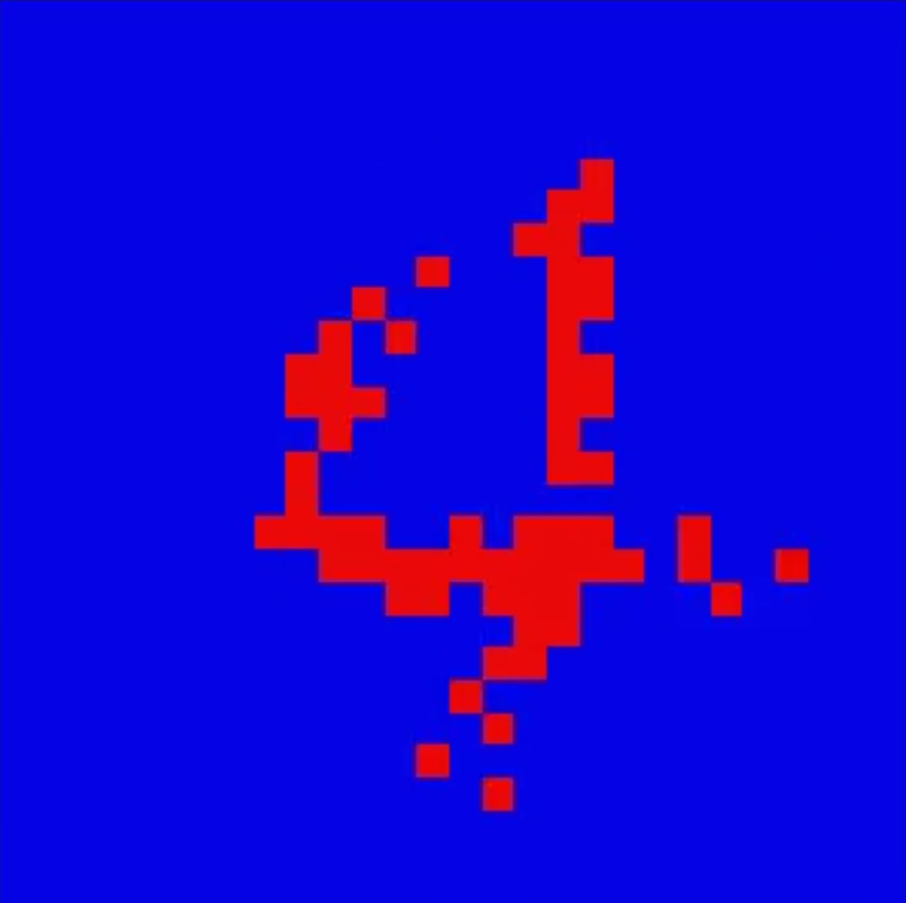
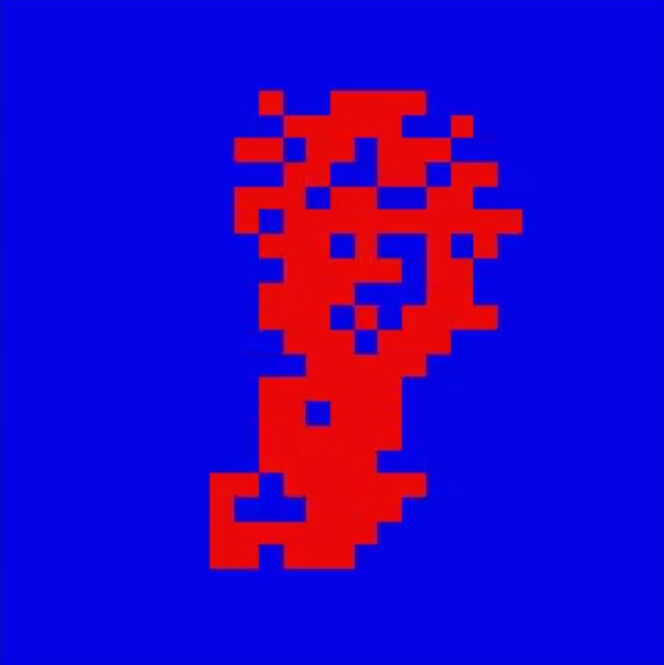
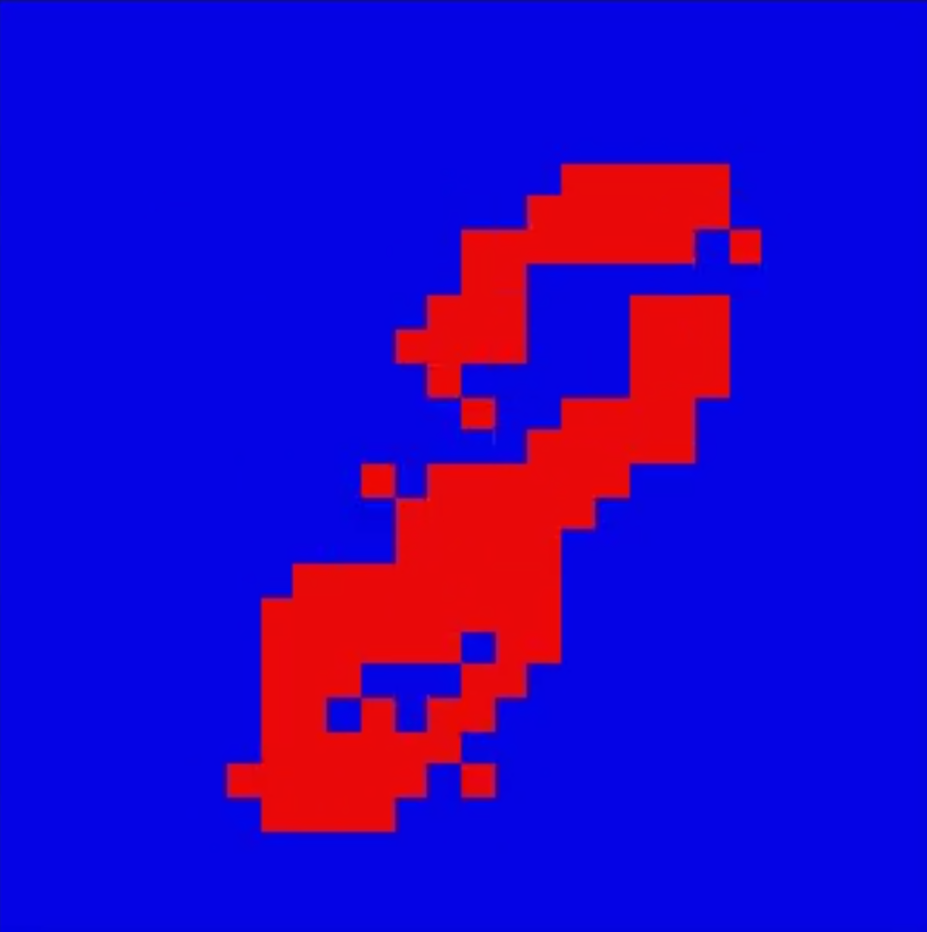
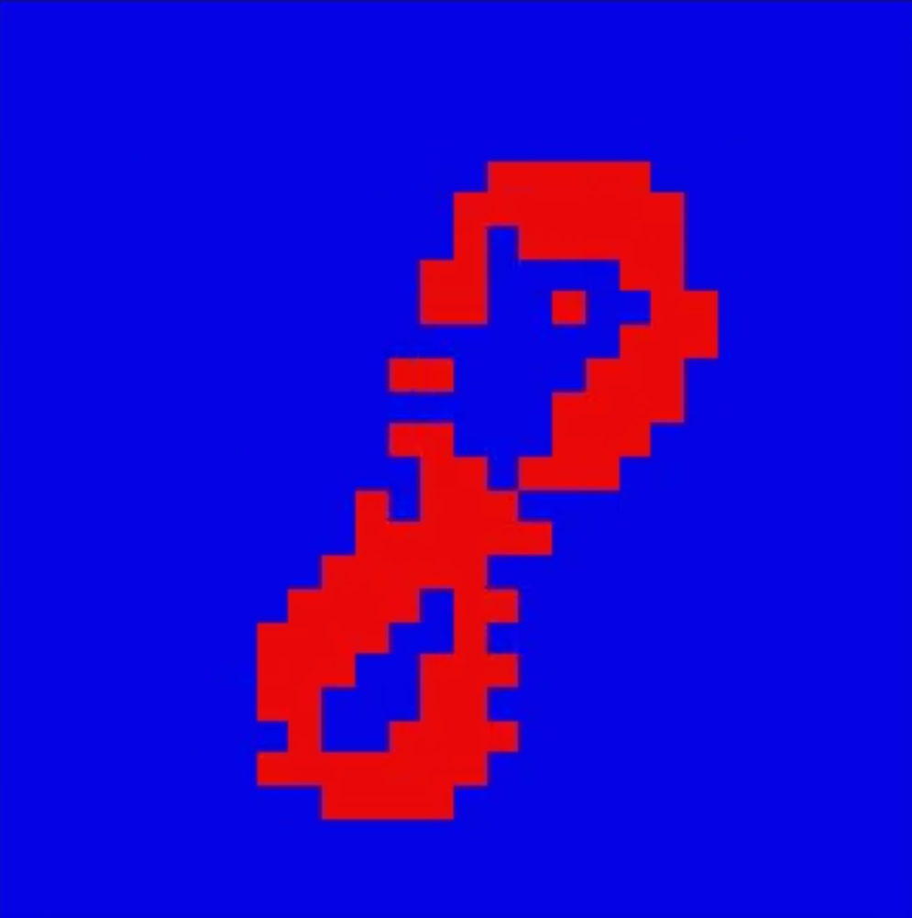
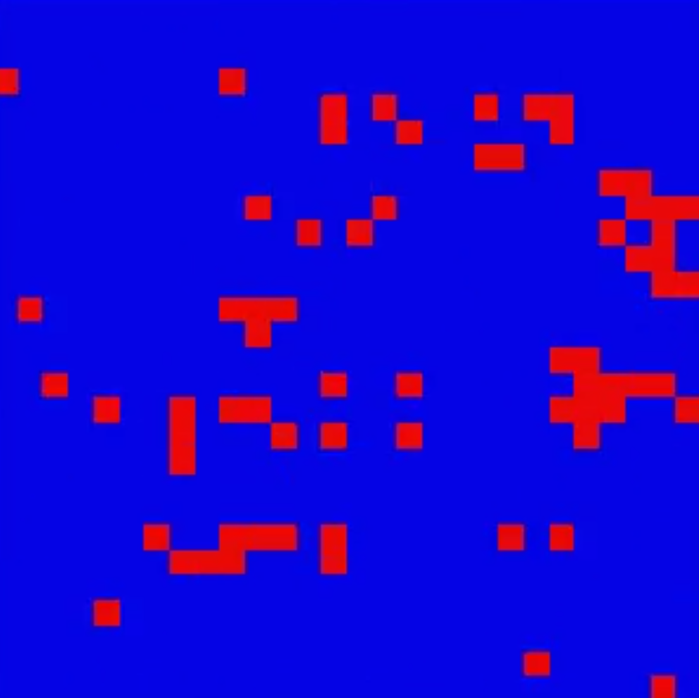
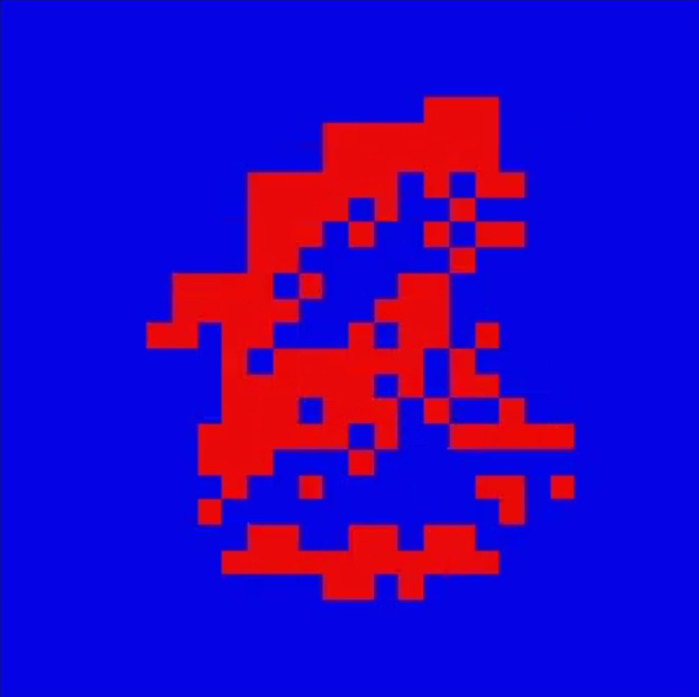
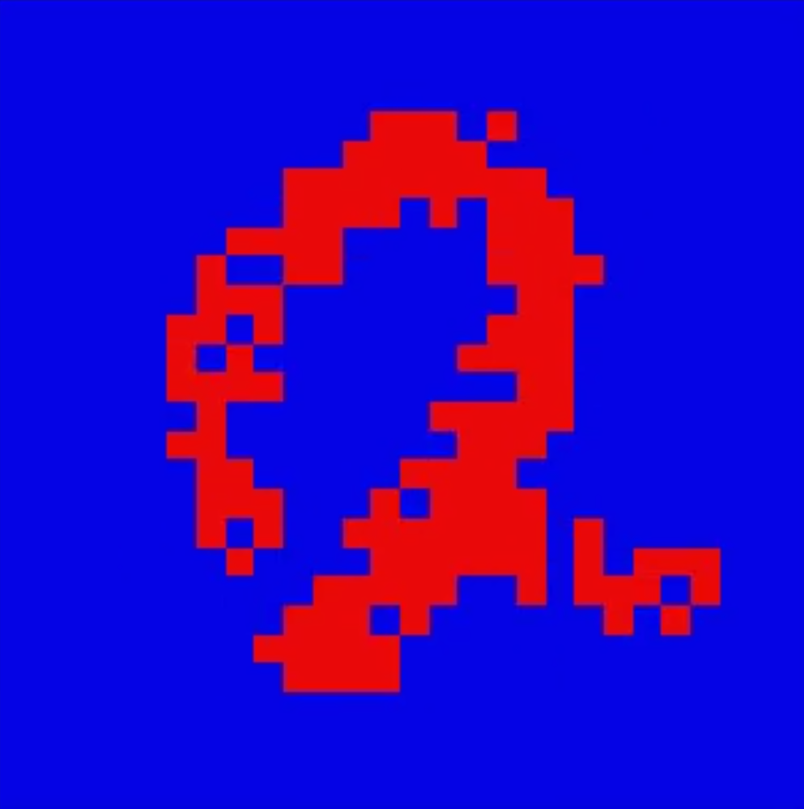
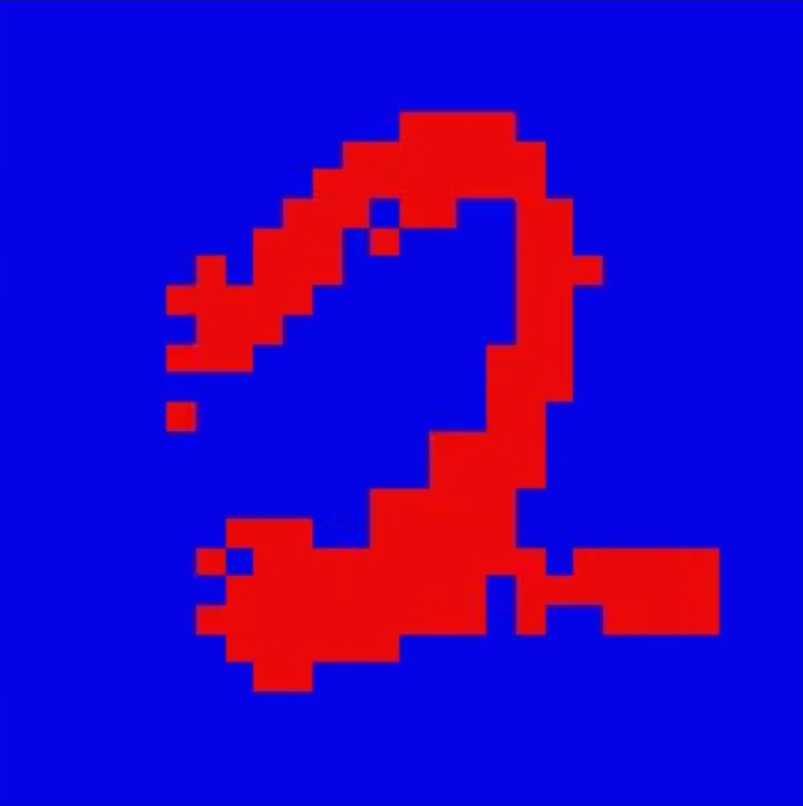
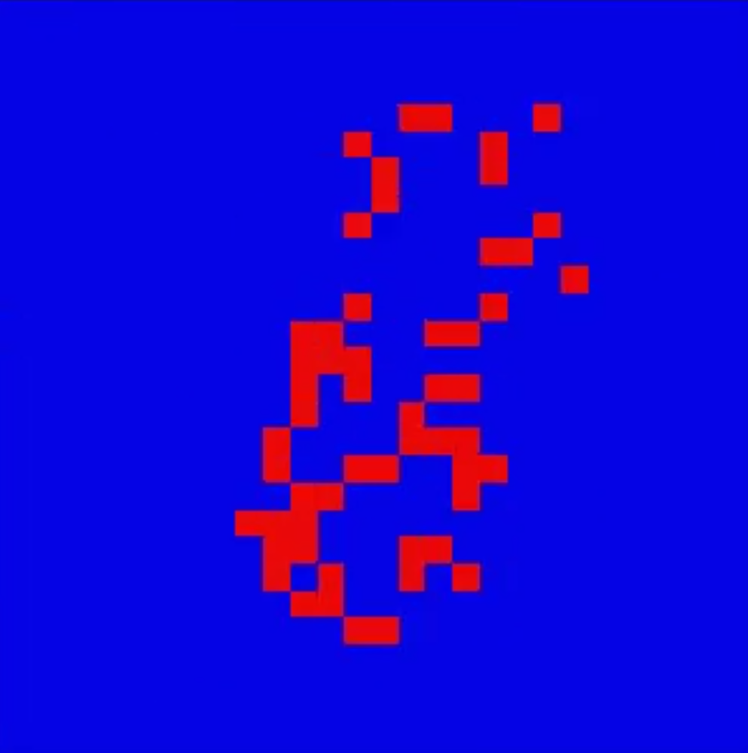
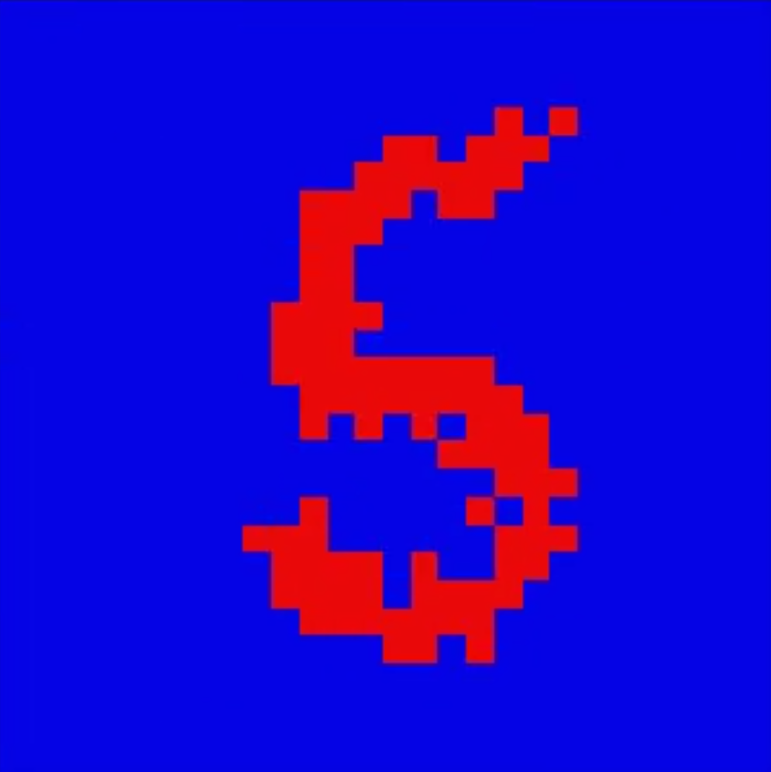
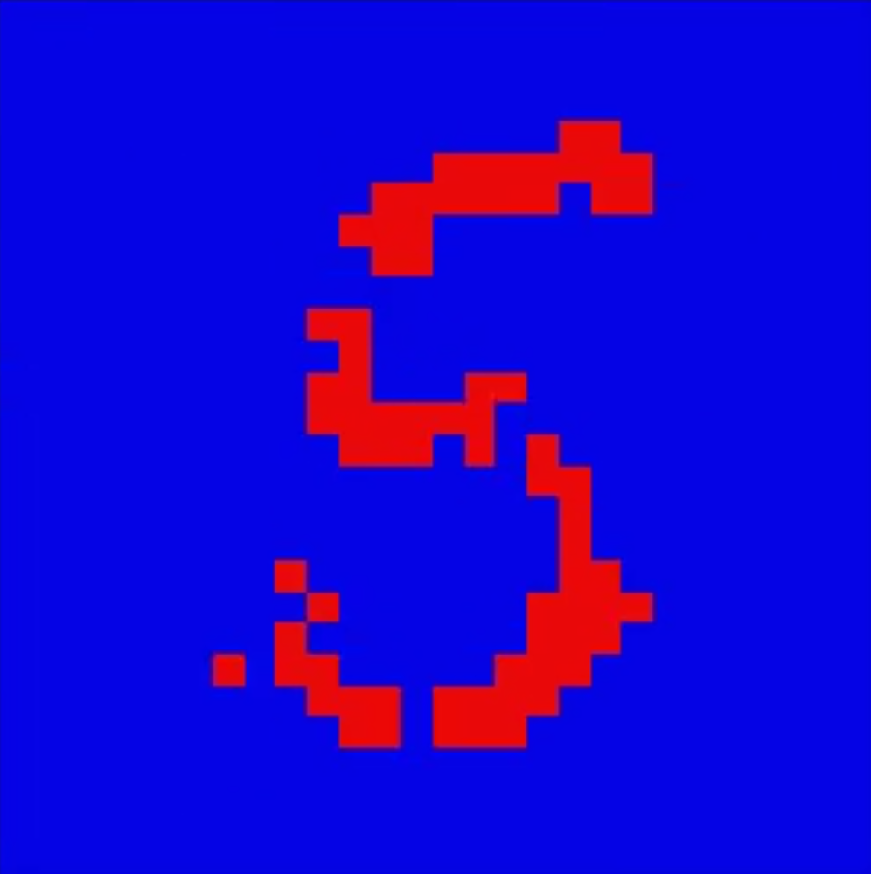
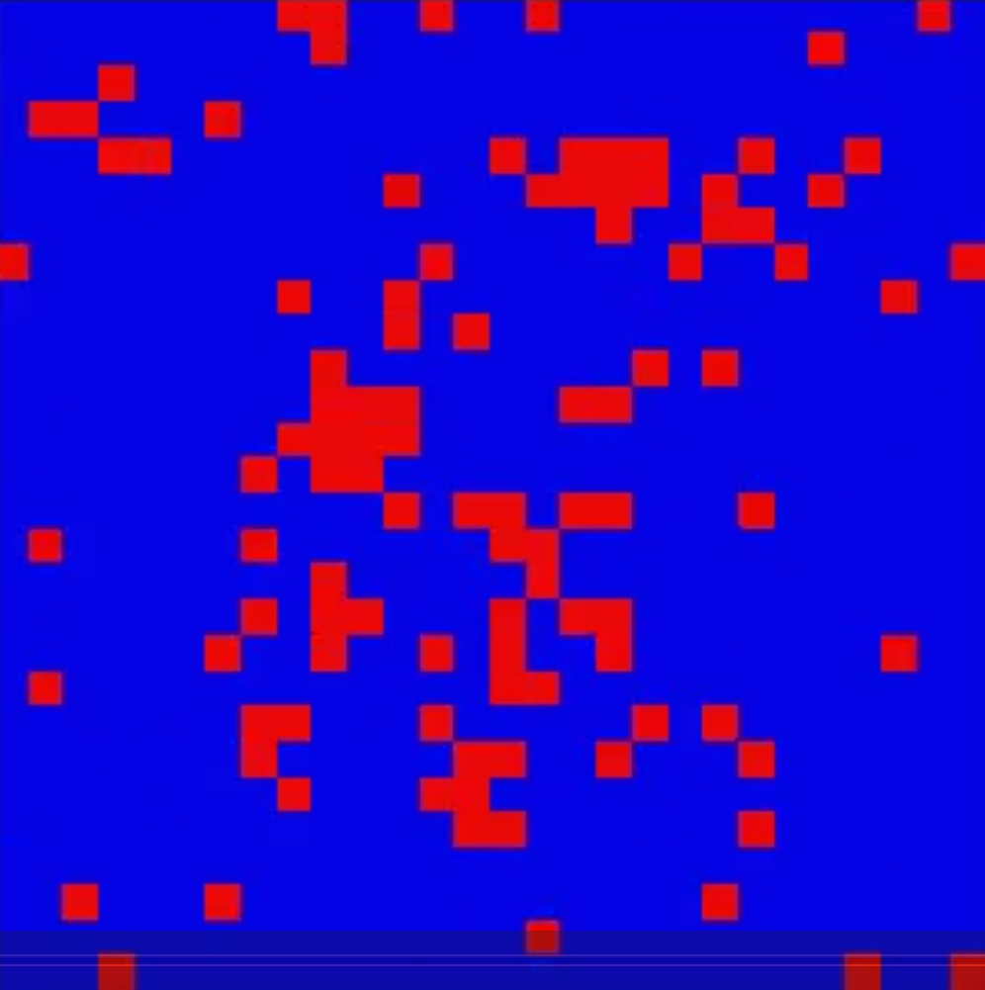
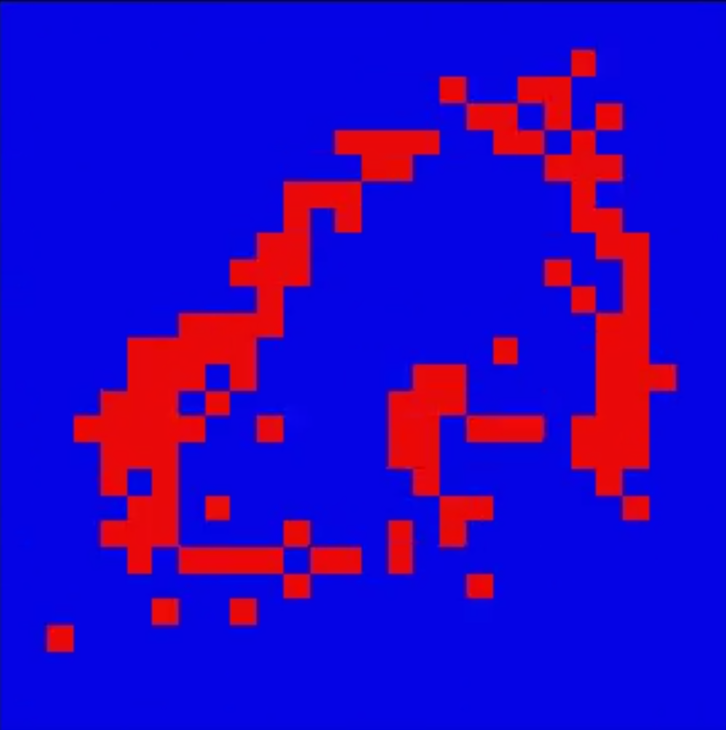
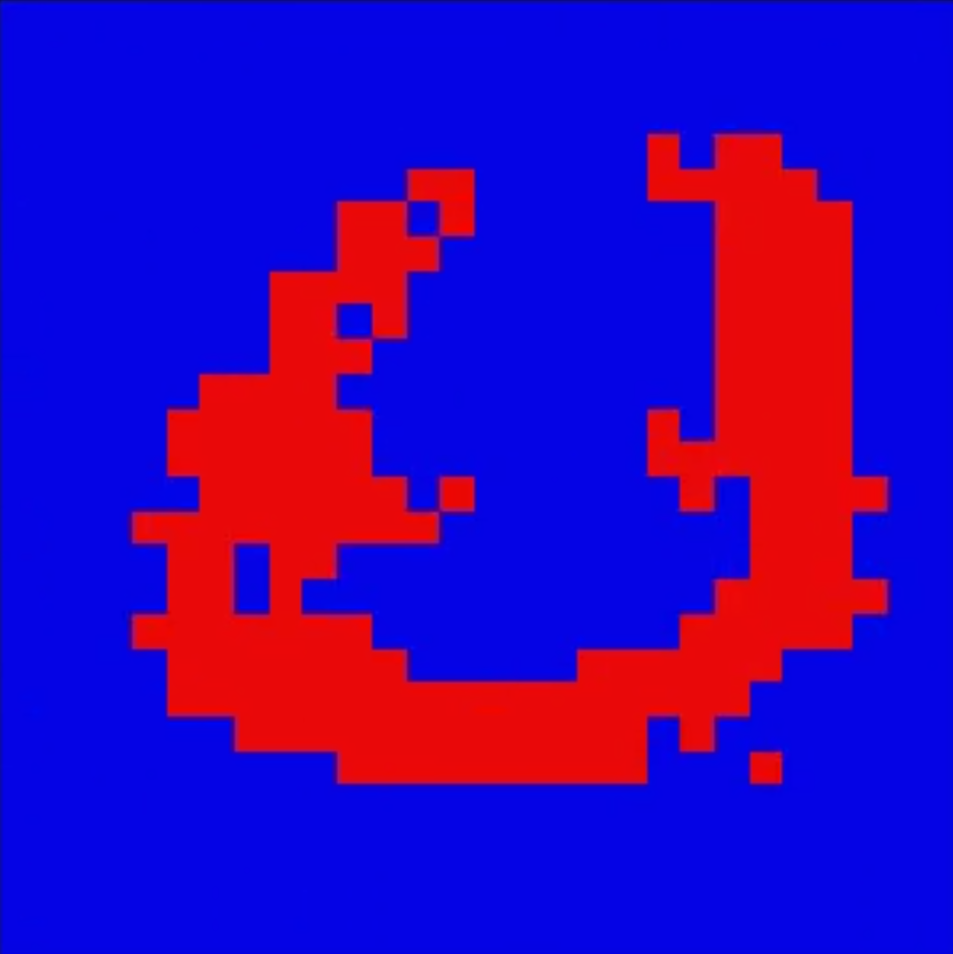
DBN as Generative Model (Generation)
The network can be used as a generative model by running alternating Gibbs sampling at the top RBM and then subsequently sampling from the top to the bottom layer
Examples of generated images per digits with 200 Gibbs sampling iteration in top RBM
6
0
3
7
1
4
8
2
5
9

Slide 11
DBN as Discriminative Model (Recognition)
as mentioned, labels are concatenated to pen layer, then recognition of digits
training each RBM for 100 epochs, we achieved:
train accuracy = 89.14 %
test accuracy = 88.83 %

Slide 12
Summary
RBM training with CD_k for maximizing data log-likelihood
RBM as generative and discriminative model
Stacking RBMs trained with CD_k, untying weights except top RBM = DBN
DBN as generative and discriminative network
Areas of improvement:
Momentum optimizer
Persistent CD_k

